Slide 1
CSCE 5400: Formal Language Automata and Computability
An algebraic characterization of finite automata in infinite words
Group | 19
Name | ID
Kishan Kumar Zalavadia | 11685261
Pavan Kalyan Reddy Vaka | 11721396
Anusha Muthyala | 11668196
Naga Lakshmi Parchuri | 11662335

Slide 2
Introduction: Background
Finite Automata (FA): Recognize patterns in input sequences (finite words).
Infinite Words (ω-words): Sequences that continue indefinitely.
ω-Automata: Variants of FA that handle infinite words.
Algebraic Characterization: Uses algebraic structures to model automata behavior, extending from finite to infinite words.

Slide 3
Introduction: Background
Finite Automata Challenge: Extending to infinite words is more complex.
Historical Milestones:
Büchi (1960s): Linked infinite sequences with ω-regular languages through monadic second-order logic.
Schützenberger (1990s): Used finite aperiodic monoids to connect automata theory with algebra for star-free languages.
Transition to Infinite Words:
Finite monoid theory struggles with infinite words.
Multi-sorted algebras bridge finite and infinite words.
Examples:
ω-Semigroups: Define mixed products (finite × infinite → infinite).
Wilke Algebras: Use the unary ω operation for infinite word recognition.

Slide 4
Motivation and purpose
Importance of Algebraic Automata Theory:
Bridges set theory and computation theory.
Applications in software verification, word processing, and network/compiler design.
Finite Automata on Infinite Words:
Essential for verifying performance and correctness in reactive software systems (e.g., operating systems, network servers).
Model checking helps identify violations of system specifications.
Practical Applications:
Tools like JavaPathFinder (NASA) and Cmc verify complex code and systems.
High complexity of automata algorithms drives interest in algebraic characterization for efficiency.

Slide 5
Formal language & Automata
Finite automata:
A finite automaton M is a 5-tuple (Q,∑ ,δ, I, F) where
Q is the finite set of possible states of M
∑ is an alphabet of M
I ⊆Q is the set of initial states of M
F ⊆Q is the set of final/accepted states of M

Slide 6





Büchi automaton
Büchi automaton is a theoretical machine which either accepts or rejects infinite inputs.
Büchi automaton, has a transition function which may have multiple outputs, leading to many possible paths for the same input; it accepts an infinite input if and only if some possible path is accepting.
Büchi automata recognize the ω-regular language.
Büchi automata are often used in model checking as an automata-theoretic version of a formula in linear temporal logic.
In a non-deterministic Büchi automaton, the transition function δ is replaced with a transition relation Δ that returns a set of states, and the single initial state q0 is replaced by a set I of initial states. Generally, the term Büchi automaton without qualifier refers to non-deterministic Büchi automata.

Slide 7


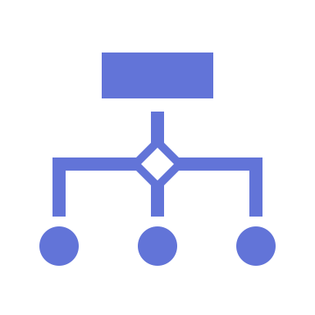




Büchi automaton
B = (Q,∑ ,δ, I, F) be a BÜchi automaton and w= w1w2w3... be an infinite word on ∑.
A run of B on w is a sequence of the form q1q2q3... such that q1 ∈I, and qi+1 ∈ δ(qi,wi), ∀i∈N.
We denote all the possible runs of B on w as ∆(w).
We say B accepts w if a run in ∆(w) visits an accepting state infinitely often.
Formally, Let p∈∆(w). The set of infinitely repeated states in p is denoted Inf(p).
Then, B accepts w if ∃p∈∆(w) s.t.Inf(p) ∩F ≠ ∅.
If B accepts w, we write w∈Lω(B), where Lω(B) is the language recognized by the automaton B.v

Slide 8
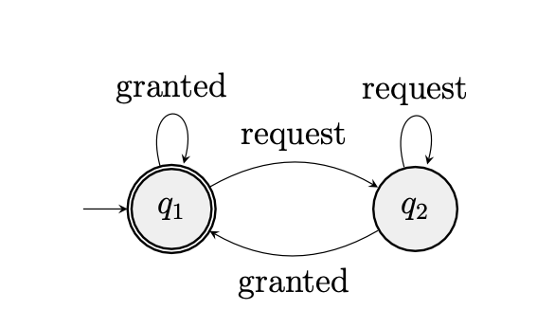
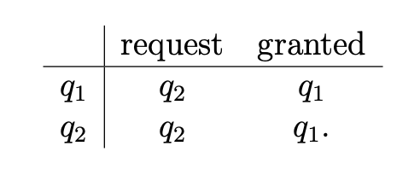
BÜchi automata Example
This automaton (B1) depicts the communication between a process P and a server S, such that P can only send a new request after its last one has been granted by S.
An example of a specification we would be interested in verifying is that every request will be granted eventually.
Fig: Transition Table

Slide 9
BÜchi automata Example
Acceptance in Büchi Automaton:
Büchi automaton B accepts an infinite sequence over {request, granted} if it visits the accepting state, q₁, infinitely often.
q₁ (the only accepting state) is accessed only after a request is granted.
Accepted Sequences:
Runs accepted by B: infinite sequences with a finite
number of requests followed by at least one granted.
This ensures every request is eventually granted.

Slide 10
BÜchi automata Example
Language Representation:
Denoted as L^{ω}(B) = (request*granted)^{ω}.
Kleene’s star ( * ): Represents finite repetition.
Infinitization operator ( ω ): Represents infinite sequences.
Recognizable ω-Language:
(request*granted)^{ω} is recognized by a Büchi automaton.
More generally, a set I of infinite words is recognizable if Lω(B) = I. Also known as an ω-rational language.

Slide 11
Kleene’s Theorem, ω-Rationality & Closure Properties
Kleene’s Theorem:
For any alphabet Σ and subset X ⊆ Σ*
X is rational if and only if it is recognized by a DFA (Deterministic Finite Automaton).
Extension to Infinite Words:
For any alphabet Σ, a set L is ω-rational if:
L is a finite union of sets in the form XY^{ω}.
Where X and Y are rational subsets of Σ*.
Notes:
Kleene’s Theorem:
"Kleene’s theorem tells us that a language X over an alphabet Σ is rational if there’s a DFA that can recognize it. This gives us a foundational link between regular languages and finite automata."
Extension to Infinite Words:
"We extend this concept to infinite words. Here, a set L is called ω-rational if it can be represented as a finite union of patterns like XYω. X and Y are rational sets over finite words, while ω represents the infinite repetition."
Properties of ω-Rational Languages:
"Interestingly, Büchi automata, which recognize infinite words, display closure properties similar to those of regular languages, meaning they’re closed under operations like union and intersection."

Slide 12
Kleene’s Theorem, ω-Rationality & Closure Properties
Properties of ω-Rational Languages:
Languages recognized by Büchi automata share similar closure properties to regular languages.
Closure Properties of Büchi Recognizable Languages:
Union: If X and Y are Büchi recognizable, then X ∪ Y is also Büchi recognizable.
Infinite Repetition: If X is a rational language, then Xω (infinite repetition of X) is Büchi recognizable.
Notes:
Kleene’s Theorem:
"Kleene’s theorem tells us that a language X over an alphabet Σ is rational if there’s a DFA that can recognize it. This gives us a foundational link between regular languages and finite automata."
Extension to Infinite Words:
"We extend this concept to infinite words. Here, a set L is called ω-rational if it can be represented as a finite union of patterns like XYω. X and Y are rational sets over finite words, while ω represents the infinite repetition."
Properties of ω-Rational Languages:
"Interestingly, Büchi automata, which recognize infinite words, display closure properties similar to those of regular languages, meaning they’re closed under operations like union and intersection."

Slide 13
ω-regular language
An ω-language is recognized by a Büchi automaton if and only if it is an ω-regular language. Every ω-regular language is recognized by a nondeterministic Büchi automaton; the translation is constructive.
Formal definition:
An ω-language L is ω-regular if it has the following form:
Aω where A is a regular language not containing the empty string
AB, the concatenation of a regular language A and an ω-regular language B
A ∪ B where A and B are ω-regular languages (this rule can only be applied finitely many times)
The elements of Aω are obtained by concatenating words from A infinitely many times.

Slide 14
ω-regular language
ω-semigroup is a two-sorted algebra S = (S_f, S_ω) equipped with:
1. Binary operation on S_f (makes S_f a semigroup).
2. Mixed product: S_f × S_ω → S_ω, denoted st.
3. Infinite product: π: S_f^N → S_ω.
Properties of ω-Semigroups:
Associativity extension: s(tu) = (st)u.
Infinite product consistency: π(s_0, s_1, s_2, ...) = π(s_0s_1...s_{k_1-1}, s_{k_1}...).
Unambiguous notation: π(s, s_0, ...) = sπ(s_0, ...).

Slide 15
Deterministic vs Non-deterministic Automata
Non-deterministic büchi automata:
Allows multiple transitions from a state.
Accepts words if any path satisfies the acceptance condition.
Key result: non-deterministic büchi automata are strictly more powerful than deterministic ones.
Example:
LLL: set of infinite words with finitely many occurrences of 'a'.
No deterministic automaton can recognize lll, but a non-deterministic one can.
Implication:
Deterministic automata for finite inputs are equivalent to non-deterministic ones, but this breaks down for infinite inputs.

Slide 16
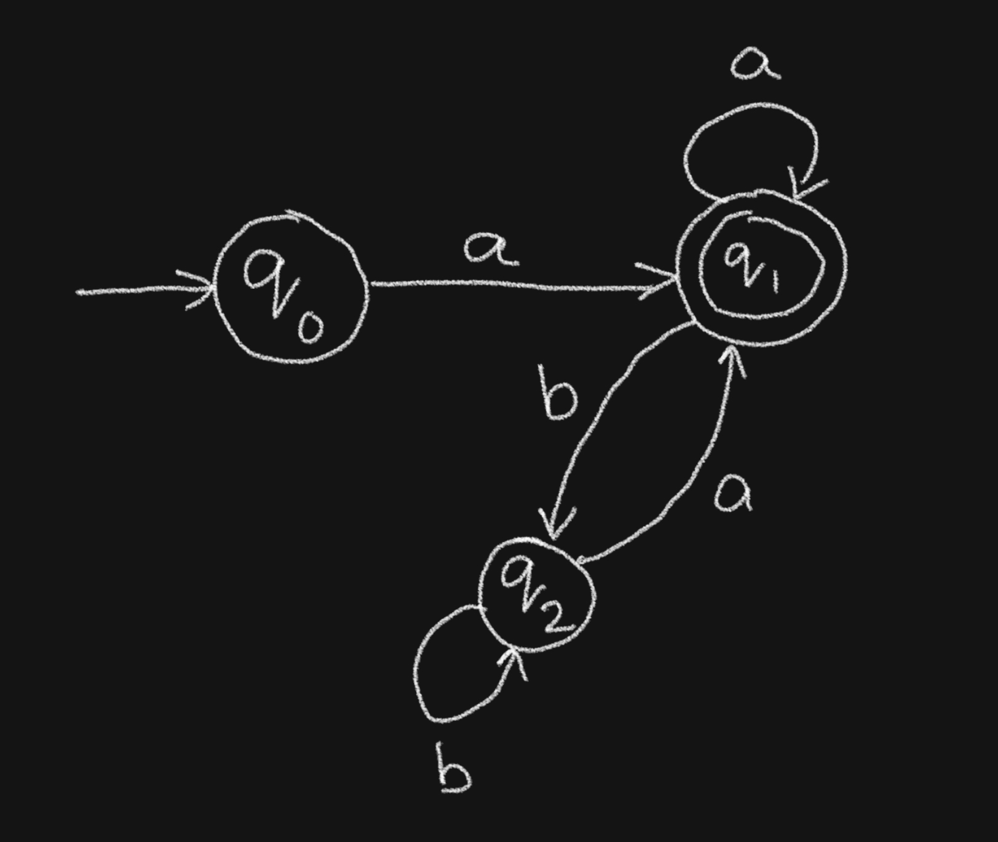
Example: Büchi Automaton
Let’s Define the Büchi Automaton B:
Q={q0,q1,q2} (states)
Σ={a,b} (alphabets)
δ (transition function):
δ(q0,a)=q1
δ(q1,b)=q2
δ(q2,a)=q1
δ(q1,a)=q1
δ(q2,b)=q2
I={q0} (initial state).
F={q1} (accepting state).
Infinite Word w=aababaababaab...
Conclusion:
The run p=q₀q₁q₁q₂q₁q₂… belongs to Δ(w)
The set of infinitely repeated states is Inf(p)={q₁}
Since Inf(p)∩F={q₁}≠∅, w∈L_{ω}​(B).
Therefore, w is accepted by the Büchi automaton B.

Slide 17
example: Kleene’s theorem
Let Σ be an alphabet.
L is an ω−rational subset of Σ^{ω} if and only if it is a finite union of sets of the form
XY^{ω} where X and Y are rational subsets of Σ*.
Let Σ={a,b}.
Define the language L⊆Σ^{ω} as: L={w∈Σ^{ω}∣w contains a finite number of b’s and then infinite a’s}.
Construction of L:
X: Finite sequences of a's and b's (finite b's), i.e., X={a,b}∗b∗.
Y: A single a, i.e., Y={a}.
Y^{ω}: Infinite repetition of a, i.e., Y^{ω}={a^{ω}}.
Language Representation:
L=XYω={a,b}∗b∗a^{ω}

Slide 18
Equivalence between Automata and Algebraic Recognition
Theorem: Let be an alphabet and X ⊆ω. Then the following statements
are equivalent:
1. X is ω−rational.
2. There exists a Büchi automaton B such that Lω(B) = X.
3. X is strongly recognized by some morphism onto a finite semigroup.
4. X is recognized by some morphism onto a finite ω−semigroup/Wilke algebra.
Example:
Alphabet: Σ={a,b}
Language: X={a^{n}b^{ω}∣n≥0}
This language includes infinite words with a finite number of 'a's followed by infinite 'b's.

Slide 19
Equivalence between Automata and Algebraic Recognition (Cont..)
X is ω-rational:
X=a∗b^{ω} is ω-rational because it is a concatenation of a finite rational language a* and infinite repetition of b (b^{ω}).
There exists a Büchi automaton B such that L_{ω}(B)=X:
The Büchi automaton starts at q0​, reads a and stays at q0​, reads b, and transitions to q1​.
q1​ is the accepting state, so it accepts the infinite repetition of b’s.
X is strongly recognized by a morphism onto a finite semigroup:
Map 'a' to 1 and 'b' to 2.
The semigroup operation reflects transitions between sequences of a’s and b’s.
X is recognized by some morphism onto a finite ω-semigroup/Wilke algebra:
The finite portion a∗ is represented by finite operations, and the infinite repetition b^{ω} is encoded by the ω-product in the ω-semigroup.

Slide 20
Conclusion
Büchi Automata & ω-Regular Languages: Büchi automata recognize ω-regular languages, which consist of infinite sequences.
Kleene's Theorem & Closure: Kleene's theorem defines regular languages, which are closed under union, concatenation, and Kleene star.
Deterministic vs Non-deterministic Büchi Automata: Non-deterministic Büchi automata are more expressive but harder to determinize.
Equivalence with Algebraic Recognition: Büchi automata and ω-semigroups/Wilke algebras are equivalent in recognizing ω-regular languages.

Slide 21
Future Scope & References
Optimization of Automata Conversions: Developing more efficient algorithms for converting non-deterministic Büchi automata to deterministic ones, minimizing state explosion.
Advanced Language Recognition: Extending the use of ω-semigroups and Wilke algebras to handle more complex temporal properties and fairness conditions in infinite-state systems.
Integration with Other Logics: Exploring the integration of Büchi automata with other logical frameworks like monadic second-order logic for broader applications in formal verification and system analysis.
References:
Ghazi, Z. (2022). An Algebraic Characterization of Finite Automata on Infinite Words (Doctoral dissertation, Bryn Mawr College).
Wikimedia Foundation. (2024, November 9). Büchi automaton. Wikipedia.
https://www.researchgate.net/publication/365487538_An_Algebraic_Characterization_of_Finite_Automata_on_Infinite_Words
https://www.irif.fr/~jep/PDF/YorkInfini.pdf
https://www.cmi.ac.in/~madhavan/papers/pdf/iisc2011-buchi.pdf

Slide 22

Thank You Questions?

